Slide 1
Project Management
Sanket Shrestha

Slide 2
Project
A project is a temporary endeavor undertaken to provide a unique product or service
A project is a (temporary) sequence of unique complex and connected activities that have one goal or purpose and that must be completed by a specific time, within budget and according to specification.
OR
A project is a sequence of activities that must be completed on time, within budget and according to specification.

Slide 3
Project management
Project management is the process of scoping, planning, staffing, organizing, directing and controlling the development of an acceptable system at a minimum cost within a specified time frame.

Slide 4
Attributes of Successful project
The resulting information system is acceptable to the customer.
The system is delivered “on time”.
The system is delivered “within budget”.
The system development process had minimal impact ongoing business operations.

Slide 5
Attributes of Failed Project
Failure to establish upper management commitment to the project.
Lack of organization’s commitment to the system development method.
Taking shortcuts through or a around the system development method
The project gets behind schedule.
The project is over budget.
The team is not trained or skilled.
Poor planning
Lack of quality standards.
Lack of communication between end users and developers.

Slide 6
Software project management
It is concerned with activities involved in ensuring that software is delivered on time and on schedule and in accordance with the requirements of the organisations developing and procuring the software.
Project management is needed because software development is always subject to budget and schedule constraints that are set by the organisation developing the software.

Slide 7
Software Project management Characteristics
Software engineering is different from other types of engineering in a number of ways. These distinctions make software management particularly difficult. some of differences are:
The product is intangible: it cannot be seen or touched. Software mangers cannot see progress.
The product is uniquely flexible.
Software engineering is not recognized as an engineering discipline with the same status as mechanical, electrical engineering, etc.
The software development process is not standardised: process may vary dramatically from one organization to another.
Many software projects are 'one-off' projects: rapid technological changes in computers and communications can make a manager’s experience obsolete (out dated). Lessons learned from previous projects may not be transferable to new projects.

Slide 8
Project Manager
Software managers are responsible for planning and scheduling project development. They supervise the work to ensure that it is carried out to the required standards and monitor progress to check that the development is on time and within budget.
The software project manager’s job is to ensure that the software project meets constraints (Budget and schedule constraints) and delivers software that contributes to the goals of the company developing the software.

Slide 9
Common activities software managers include:
Management
Leadership
Technical problem solving
Problem solving
Conflict management
Customer relations
Team management
Risk and change management

Slide 10
Management activities:
Proposal writing:
Project planning and scheduling.
Project costing.
Project monitoring and reviews.
Personnel selection and evaluation.
Report writing and presentations.

Slide 11
Project staffing
May not be possible to appoint the ideal people to work on a project
Project budget may not allow for the use of highly-paid staff;
Staff with the appropriate experience may not be available;
An organisation may wish to develop employee skills on a software project.
Managers have to work within these constraints especially when there are shortages of trained staff.

Slide 12
Project planning
It involves making detailed plan to achieve the objectives.
Probably the most time-consuming project management activity.
Continuous activity from initial concept through to system delivery. Plans must be regularly revised as new information becomes available.
Various different types of plan may be developed to support the main software project plan that is concerned with schedule and budget.

Slide 13
Types of plan
Quality Plan: It describes quality procedures and standards that will be used in a project.
Configuration management plan: it describes the configuration management procedures and structures to be used.
Maintenance plan: It predicts the maintenance requirements of the system maintenance costs and effort required.
Staff development plan: It describes how the skills and experience of the project team members will be developed.

Slide 14
Project planning process
Make initial assessments of the project objectives
Define project milestones and deliverables
While project has not been completed or cancelled loop
Draw up project schedule
Initiate activities according to schedule
Wait ( for a while )
Review project progress
Revise estimates of project parameters
Update the project schedule
Re-negotiate project constraints and deliverables
if ( problems arise ) then
Initiate technical review and possible revision
end if
end loop

Slide 15
The project plan
The project plan sets out:
The resources available to the project;
The work breakdown;
A schedule for the work.
The details of the project plan vary depending on the type of project and organization. However, most plans should include the following sections:

Slide 16
Contd…
Introduction: This briefly describes the objectives of the project and sets out the constraints(eg.budget,time etc)that affect the project management
Project organization: This describes the way in which the development team is organized, the people involved and their roles in the team.
Risk analysis: This describes possible project risks, the likelihood of these risks arising and the risk reduction strategies that proposed.
Hardware and software resource requirements: This specifies the hardware and the support software required to carry out the development. If hardware has to be bought, estimate of the prices and delivery schedule may be included.
Work breakdown: This sets out the breakdown of the project into activities and identifies the milestones and deliverables associated with each activity.
Project schedule: This shows the dependencies between activities, the estimated time required to reach each milestone and the allocation of people to activities.
Monitoring and reporting mechanisms: This defines the management reports that should be produced, when these should be produced and the project monitoring mechanisms used.

Slide 17
Milestones and Deliverables
Activities in a project should be organised to produce tangible outputs for management to judge progress.
Milestones are the end-point of a process activity.
A project milestone is a predictable state where a formal report of progress is presented to management.
Deliverables are project results delivered to customers. It is usually delivered at the end of some major phase such as specification or design. Deliverables are usually milestones, but milestones need not be deliverables.
Milestones may be internal project results that are used by the project manager to check project delivered to the customer

Slide 18
Contd…
To establish milestones, the software process must be broken down into basis activities with associated outputs. The fig (below) shows possible activities involved in requirement specification when prototyping is used to help validate requirements. The milestones in this case are completion of the outputs for each activity. The project deliverables, which are delivered to the customer, are the requirements definition and the requirements specification.

Slide 19
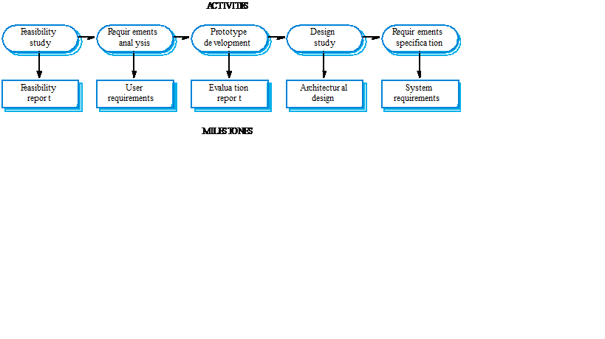
Contd…
Milestones in the RE process

Slide 20
Project scheduling
It is the one of the most difficult job for a project manager. managers estimate time and resources required to complete activities and organize them into coherent sequence.
It involves:
Split project into tasks and estimate time and resources required to complete each task.
Organize tasks concurrently to make optimal use of workforce.
Minimize task dependencies to avoid delays caused by one task waiting for another to complete.
It‘s Dependent on project managers intuition and experience.
Project scheduling involves preparing various graphical representations showing project activities, their durations and staffing.

Slide 21
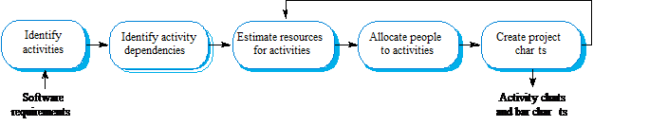
The project scheduling process

Slide 22
Scheduling problems
Estimating the difficulty of problems and hence the cost of developing a solution is hard.
Productivity is not proportional to the number of people working on a task.
Adding people to a late project makes it later because of communication overheads.
The unexpected always happens. Always allow contingency in planning.

Slide 23
Bar charts and activity networks
Graphical notations used to illustrate the project schedule.
Show project breakdown into tasks. Tasks should not be too small. They should take about a week or two.
Activity charts show task dependencies and the critical path.
Bar charts show schedule against calendar time.

Slide 24
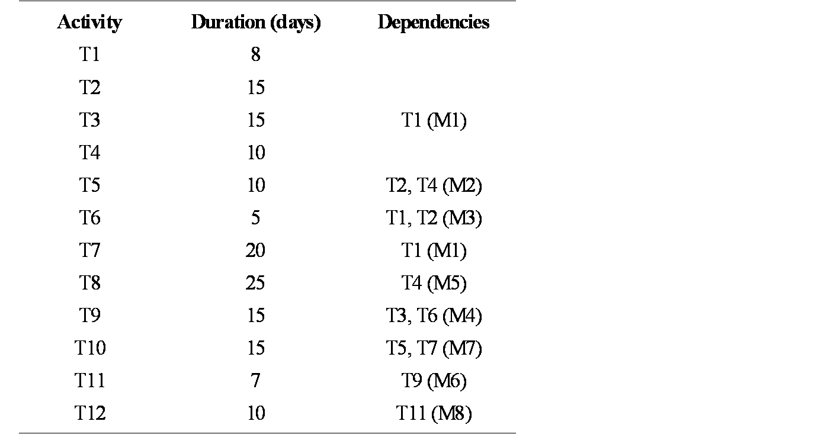
Task durations and dependencies

Slide 25
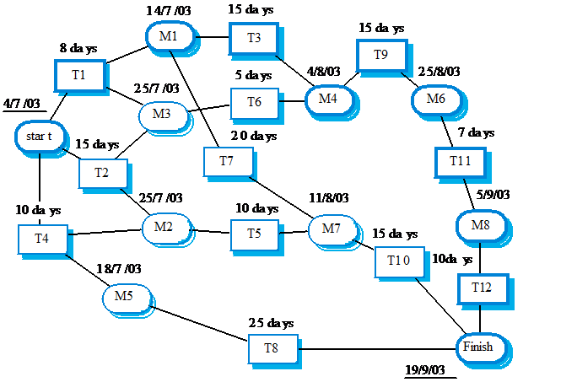
An Activity Network

Slide 26
There are four types of intertask dependencies:
Finish-to-start (FS) - the finish of one task triggers the start of another task.
Start-to-start (SS) - the start of one task triggers the start of another task.
Finish-to-finish (FF) – two tasks must finish at the same time.
Start-to-finish (SF) – the start of one task signifies the finish of another task.

Slide 27
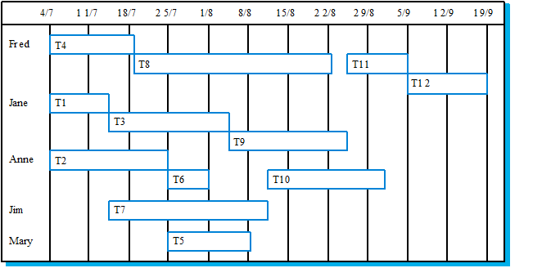
Staff allocation vs.Timechart

Slide 28
Planning techniques
Presentations:
A) Work breakdown Structure
B) Gantt Chart
C) Critical Path Analysis
D) PERT

